Slide 1

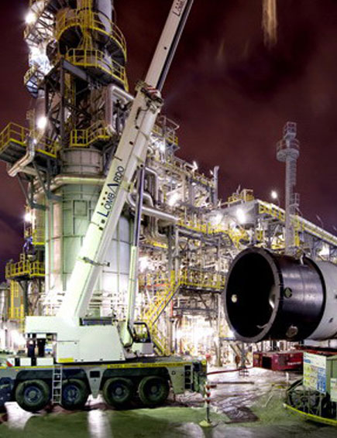

Bio-on & Techint Ww Construction PARTNERSHIP
Techint Group:
Annual Revenues: US$ 22 billion
Permanent Employees: 55,000
Number of projects realized: more than 150 EPC plants in the last 15 years.
Number of countries where Techint worked: 38
Number of permanent employees and supervisors: 850
Engineering capacity: over 900.000 man hours/year
STRICTLY CONFIDENTIAL

Slide 2
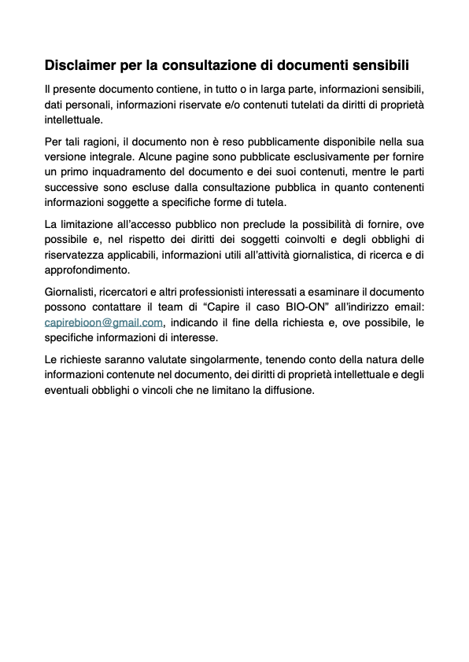

Slide 3
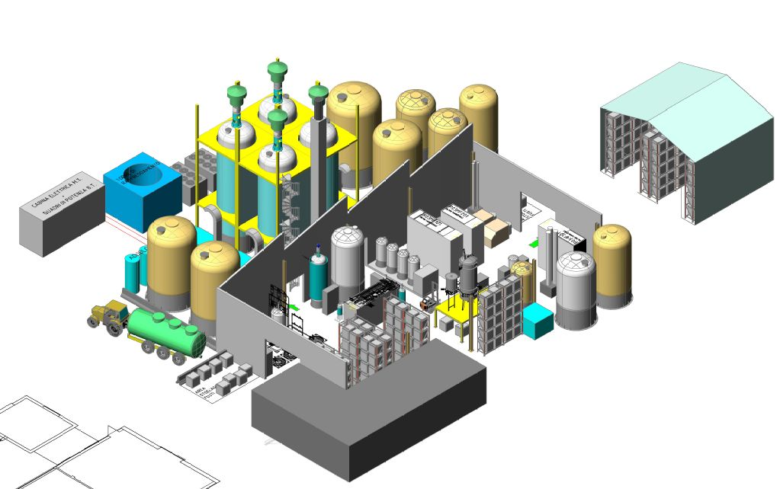
Bio-on & Techint Ww Construction PARTNERSHIP
STRICTLY CONFIDENTIAL
2000 TONS ANNO impianto pilota PHAs da co-prodotti barbabietole

Slide 4
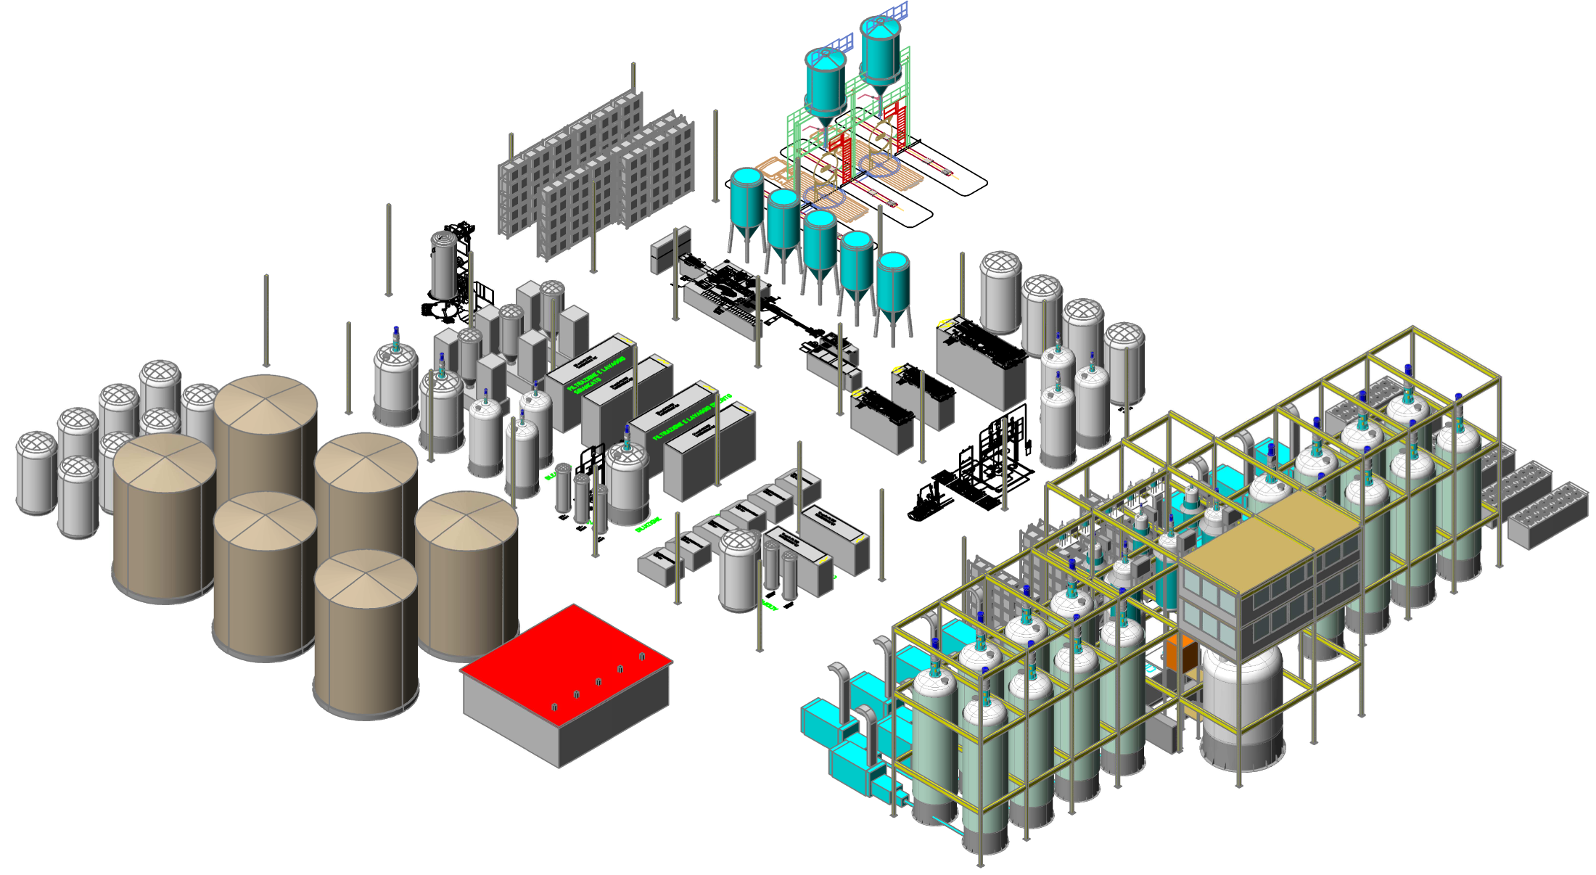
Bio-on & Techint Ww Construction PARTNERSHIP
STRICTLY CONFIDENTIAL
10.000 TONS ANNO impianto industriale PHAs da co-prodotti barbabietole

